Slide 1
Barclays
Tech Challenge
The University of Bradford
Team 1

Slide 2
Contents
Introduction
The Pot System
Inspiration
UX
Demonstration
Scope
Communication and Human Resources
Job Descriptions
Communication Methods
Hiring Methods
Quality Assurance Plan
Roles
Costs
Procurement

Slide 3
Introduction
Team of 6 Bradford Students
Five 1st Years, One 2nd Year
Open Banking
App Synopsis
Notes:
Who we are (5 member team, From Bradford University, made up fully of first years.)
Quick Introduction of the Pot system (What it is and what it allows us to do)

Slide 4
Student Life

Slide 5
Inspiration
Klaudia was inconvenienced by having to get her housemate to transfer funds to her when they’re out shopping
It takes time to transfer between two different banks, sometimes she wouldn’t receive the money in time for the food shop
The app allows for instant transfer from any bank account, no matter the bank in a quick and effective manner
Notes:
Frustration at the lack of flexibility
Gets rid of the need for multiple bank accounts each doing their own thing
Students whom are wanting to go shopping w/ housemates have access to global pot for them, then the leader can then pay using this pot.
Ideas from PayPal’s pooling feature, but is more accessible and user friendly
Due to endorsement by multiple high end banks, then the public would be more inclined to use this.

Slide 6
The Pot System
A system which allows for two or more people to share a ‘pot’ of money and both have access to the funds
Easy access to the pot from multiple accounts
Allows separate pots for various uses; eg. Utility Bills, Regular Direct Debits, Standing Orders, etc.
Transfer on-day of billing
Smooth Transfer from different bank accounts to the pot, without having to exit the app
Notes:
Overview,
Key Features
Functionality
Customisability
Constant On Screen balance

Slide 7
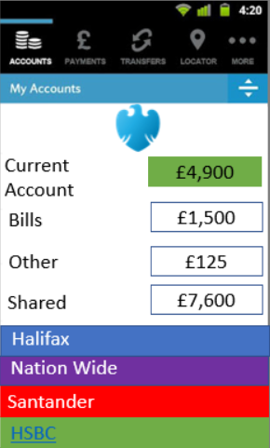
User Experience - Initial Design
Notes:
Screenshots

Slide 8
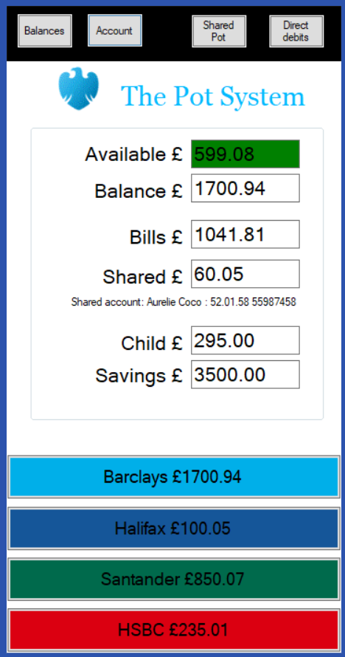
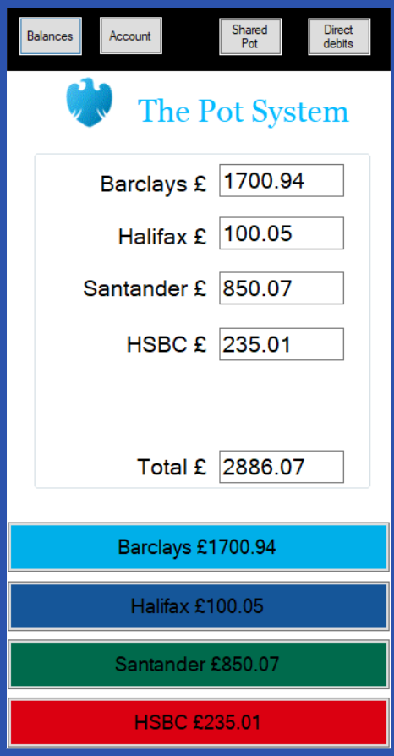
User Experience - Current Design
Notes:
Screenshots

Slide 9
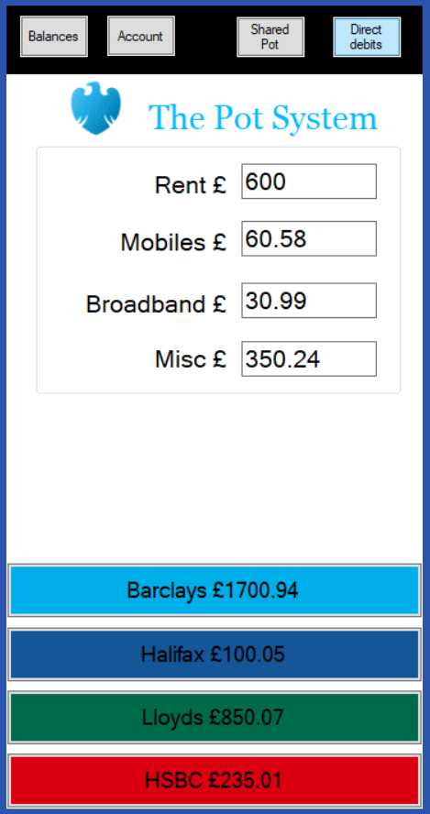
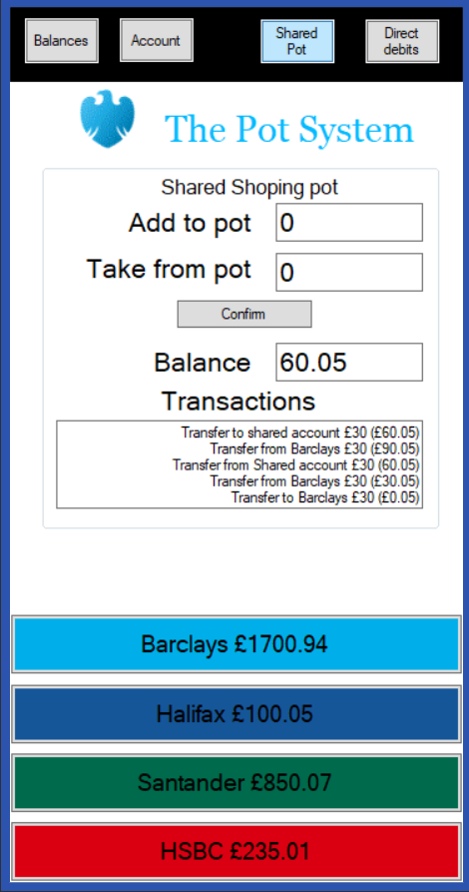
User Experience - Current Design
Notes:
Screenshots

Slide 10
Demonstration
‘The Pot’

Slide 11
Scope

Slide 12
Scope
At the end of this project the team has to deliver:
Fully working and tested app. It has to be well documented and ready to be edited/changed by any other specialists if ever needed.
Advertisement video to share online containing information about best functions this app can give for the everyday user.
Other advertisement strategies will be provided: posters/ emails and etc.

Slide 13
Continuous on Scope
Resources available for team members:
There will be:
Program Manager
Project Managers
Solution Architect
Business Analyst
Service Manager
Test Manager
UAT Manager
UAT Analysts
IT Security Manager
Technical Development Lead
Programmers
BAU Support Team Lead
Three BAU Support Team Analysts available to contact for relevant issues or questions.
Any equipment that will be decided to be used will be provided by Barclays.
Everything needed for the video will be provided from extra money in the budget.

Slide 14
Communication
and
Human Resources

Slide 15
Job Descriptions
Project manager £400/day | Programme manager £600/day | Solution architect £600/day | Test manager £400/day | Business analyst £350/day | Technical development Lead £350/day
This person is responsible for the successful delivery of one or a few aspects of the plan for the project. | This person is responsible to successfully deliver the proposed project. He/she co-ordinate whole project and management. | This person is the one who is responsible for the team's architecture. The role is to design decisions for solutions to get the best outcome. | This person is responsible for the success of tests made for the product. This involves planning, management and resolution of issues that impede the test effort. | This person works with functional or business areas to make/produce design proposals. The individual in this role must ask the right questions to make sure that solutions are appropriately designed. | This person is responsible for leading a team of developers working on this project. He/she is responsible for the quality of the product and they are “hands-on” with the code.

Slide 16
Job Descriptions
Technical developer (Built) £300/day | IT Security £400/day | Service manager £500/day | BAU Support team lead £325/day | BAU support team analyst £275/day | UAT manager £350/day | UAT analyst £300/day
This is a person who actually programs the product. He/she writes/debugs and executes the source code. This person must have a good understanding in the language used to code. | This person is responsible for protecting the network, systems & infrastructure used for the project. They have to make sure that data is safe from unauthorised access or any damage. | This person has to make sure that services meet the business needs and are delivered in the right way. These people are managing the service lifecycle. | This person leads the team of support specialists. You have to make sure that they are doing what they suppose to do and help them with it. | This person has to help customers to use this new product – answer all questions, solve problems they face or do anything else that is needed. | It is a person who will lead the testing team, help them to follow the plan test manager made for them. | A person who will test the product – different people are responsible/testing different parts of the product.

Slide 17
Communication
Methods
Hiring Methods
While looking for right people to work on this project, we will follow usual hiring patterns.
If you are interested more on that, please ask after the presentation.
Via the internet;
Emails, Webex
Scrum Meetings;
Presentations
Notes:
To pass important information to more than a few people or send files, email will be used. For simple face calls or messaging team member can use Skype or Facebook (this makes simple, day-to-day conversations easier).
Also, Webex will be used to have video or simple audio calls with team leaders.
Face-to-face meeting
Presentations :
To present ideas, discuss important things or have conversations about work that was already done for the project, team leaders will arrange the meetings.
It should be attended by everyone who is invited.
Overtime pay :
In case of needing anyone from the team for any extra time (time that is above the normal contractual working hours in the contract), it will be paid in the same rate employee is paid for every day.

Slide 18
Project Quality Plan

Slide 19
Quality Plan is provided to make sure that project will be handled in the best way possible and it is approved by Program Manager.
This will assure that:
Project deliverables meet their stated requirements
Project management processes are appropriately followed.
The Approach to best possible quality of the Program Manager and other team leads will achieve this by:
Early reviews of all important documents.
Use the well-written and anchored quality standards and procedures for each work package.
Using Satisfaction of a user as a guidelines for quality if there is no existing quality standards or procedures or they are not well defined.
Quality control for this project will focus on the deliverables of the project, monitors them to verify that they are completed in the best quality.

Slide 20
Possible risks for the project
Risk | Risk level (L/M/H) | Likelihood of event | Mitigation strategy
Project Size
Person hours | H: more than they were asked to work for | Likely | Asking them to work days that will be paid as promised.
Team size peak | H: could need more people that originally employed | Certainly | Hiring few extra people to help team finish the project.
Project Definition
Users knowledge | M: not everyone has same knowledge with technologies but most people do | Unlikely | If there is any questions there will be a phone line to call and ask questions.
Deliverables unclear | L: they are all well defined | Unlikely
Cost unrealistic | L: well predicted with set costs for everything needed | Unlikely

Slide 21
Costs and Timeline

Slide 22
Stage 1 - INITIATION
(2 weeks)
Defining solutions, objectives and problems.
People needed for this stage:
Program Manager - 10 days/£6000
2 Project Managers - 10 days each/£4000 each
£50 000 for the advertisement.
£250 000 for the salaries of the employees.
£150 000 extra money, going to used to be used as cover money for the overtime.

Slide 23
Stage 2 - PLANNING
(4 weeks)
Broke down project to parts/stage and fully planned.
People needed for this stage:
Program manager - 20 days/ £12000
2 Project Managers - 20 days each/ £8000 each
Business Analyst - 20 days/ £7000
Solution Architect - 20 days/ £12000
Service manager - 20 days/ £10000

Slide 24
Stage 3 - EXECUTION
(18 weeks)
Code new functionality to the app, market it, test and document.
People needed for this stage:
Program Manager - 36 days/ £21600 IT Security - 35 days/ £14000
Test Manager - 20 days/ £8000 2 Technical Development (Builds) - 90 days each/
3 UAT Analysts - 25 days/ £7500 £27000 each
2 Project Managers - 36 days/ £14400
UAT Manager - 25 days/ £8750

Slide 25
Stage 4 - CLOSE-OUT
(4 weeks)
Everything is finalized and help for the users is provided to start using new functionality.
People needed for this stage:
Program Manager - 20 days/ £9000
BAU Support Team Lead - 20 days/ £6500
3 BAU Support Team Analysts - 20 days each/ £5500

Slide 26
Procurement
Notes:
In the event of a Hacking, Cyber Attack or information Leak, contacts would be in violation and compensation would have to be paid out to all parties effected. Once contracts are negotiated, the cost of any mishaps will have to be paid out based on agreed figures. However, it is best to keep in mind, This is the worst case scenario so preparing for this mean we are ready for the worst. This means it is critical on a business and money stand point as well as a ethical stand point to ensure the best systems and programmes are used to keep the third party data secure and the Mobile app from being infiltrated by malicious users.

Slide 27
Procurement
In terms of the procurement, Materials are needed to a small degree but the main focus should be on the information needed from third parties.
As detailed in the business plans and specifications above, the open banking mobile app we are proposing to develop, will allow users to access their banking details not just Barclays customers
These agreements will cost, that is a given. These costs and contacts should be discussed and agreed on before we move forward with the mobile application.
In terms of physical computer laboratory and software’s needed for developing the mobile application including the GUI (Graphic User Interface) and linking databases, Barclays as a global company would have this side covered.
Notes:
. This means contracts and legal documents need to be made based on agreements from other popular banks such as HSBC, Santander, Halifax and more. As Barclays will not have the information from customers who have signed up with external banking societies, the external banks must agree to sharing the customer data as should the customer, else this project cannot proceed. The legal agreements have to specify this shared data usage. The banks who agree to the deal must also support Barclays in processing and updating information and agreements must cover any information leeks, errors, what information can and cannot be presented as well as the open banking requirements.
The latest these contacts can be agreed by would be before this project can be ready to deliver to the public as a final deadline. As we have not the information and status to discuses with Barclays on fee’s and external banks in regards to fee’s, for Our proposed prototype this value remains undetermined. However, the idea must be considered. Therefore, if customers are from external banking societies they will receive a small charge, and will have the opportunity to switch to Barclays and have no charge. In terms of a business perspective this ‘Donkey and Carrot’ Approach is good business. This will help to pay towards the agreed fees to the external banks or solve that problem if Customers switch to Barclays.
They have a range of laboratories, Working areas and the equipment to house the databases and network demands. Depending on the staff requirements voiced clearly in the Human Resources Section above, a small team would be needed so the laboratory and software requirements will be small.

Slide 28
Barclays
Tech Challenge
Thank you for Listening,
Any Questions?

